Slide 1
HW3
2020 Introduction to Computer Graphics

Slide 2
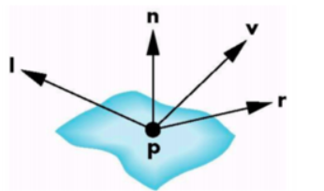
How to determine light intensity
We can simply use the included angle of the reflection and view vectors.
L is a vector towards the light source
V is a vector towards the camera position
R is a vector which is the reflection of L
N is a vector which is the normal of the point P

Slide 3
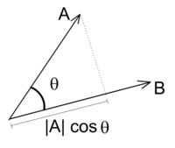
How to determine light intensity
If two vectors are unit vectors. Then we can get cosθ by doing dot products of the two vectors.
A．B = |A||B| cos θ
The smaller θ is, the larger cos θ is. According to the Phong reflection model, we can determine the light intensity based on cos θ.
If cos θ < 0, θ must bigger than 90°. In this case, this position cannot be illuminated.

Slide 4
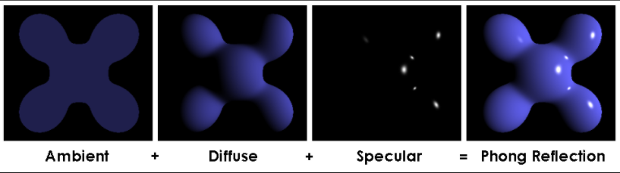
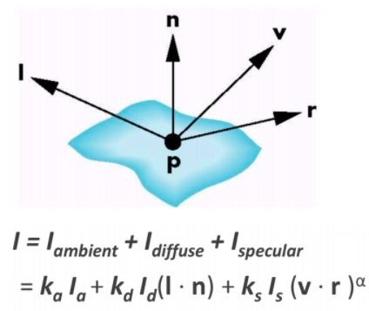
Phong shading
K is the reflectivity of each component of the material
Parameters of model material:
Ambient reflectivity (Ka) : 1 1 1
Diffuse reflectivity (Kd) : 1 1 1
Specular reflectivity (Ks) : 1 1 1
L is the intensity of each component of the light.
Parameters of light:
Ambient intensity (La) : 0.2 0.2 0.2
Diffuse intensity (Ld) : 0.8 0.8 0.8
Specular intensity (Ls) : 0.5 0.5 0.5
gloss (Specular shininess factor) : 25
α is the glossiness of the material.

Slide 5
Phong shading - pseudocode
void main()
{
object_color = texture2D(Texture, texcoord);
ambient = La * Ka * object_color;
diffuse = Ld * Kd * object_color * dot(L,N); // must > 0
specular = Ls * Ks * pow(dot(V,R), gloss);
color = ambient + diffuse + specular;
}

Slide 6
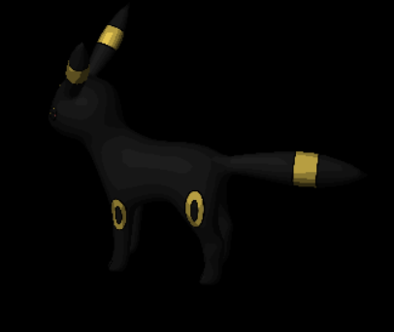
Toon shading - pseudocode
void main()
{
object_color = texture2D(Texture, texcoord);
Decide a level by calculating the included angles between the Light and normal vectors
if (level > 0.95) intensity = 1;
else if (level > 0.75) intensity = 0.8;
else if (level > 0.50) intensity = 0.6;
else if (level > 0.25) intensity = 0.4;
else intensity = 0.2;
Color = Kd * object_color * intensity ;
}
Level > 0.95
0.95 > Level > 0.75
0.75 > Level > 0.5

Slide 7
Edge effects
normal
V
center
camera
object
V
normal

Slide 8

reminder
the light position, camera position and the model position might not be in the same space. If so, you need to do some space conversion. Therefore you might need some inverse matrices to do that.
For example, to retrieve inverse model matrix, you can do inverse transformation and get current matrix.
This will work in this homework, but actually it is the wrong way to do the space conversion.

Slide 9
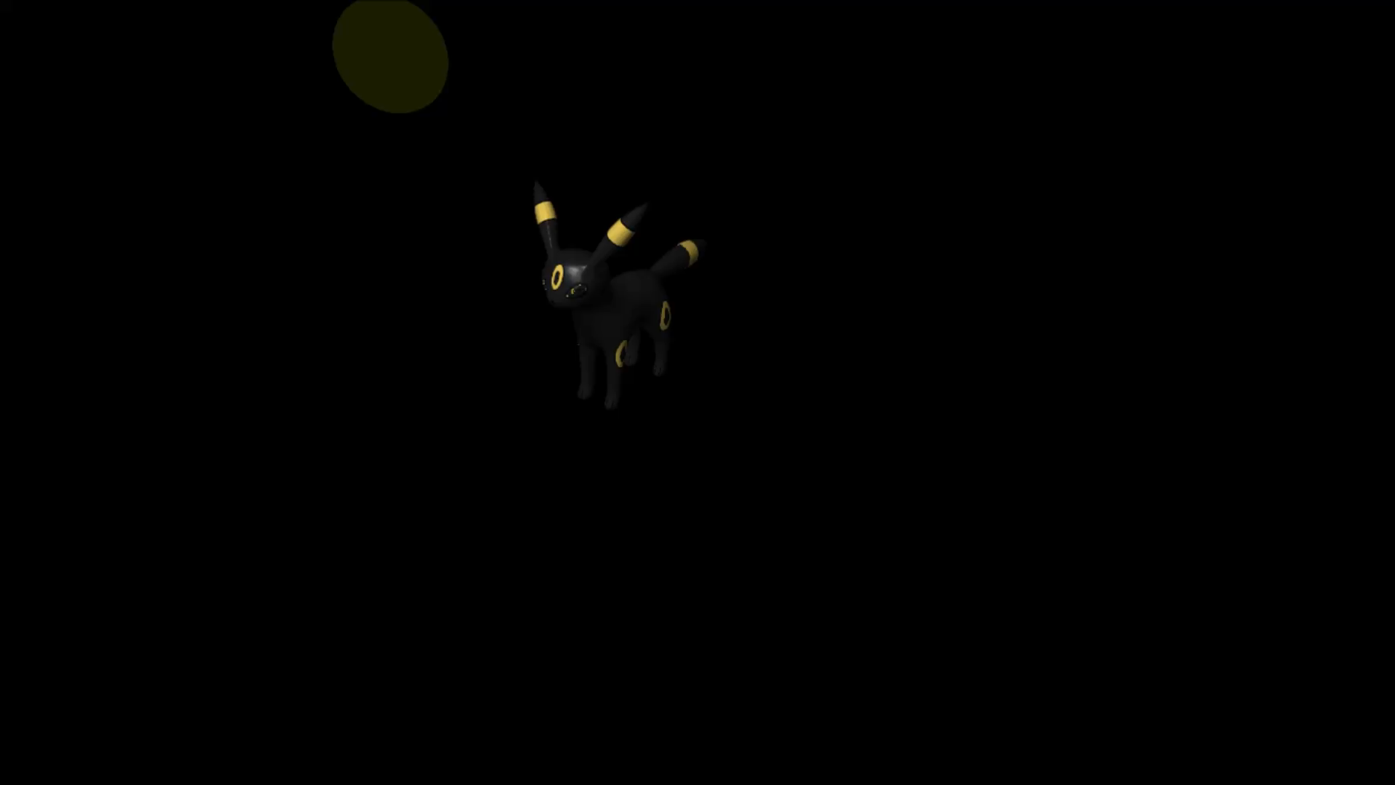
Homework 3 - Shading

Slide 10
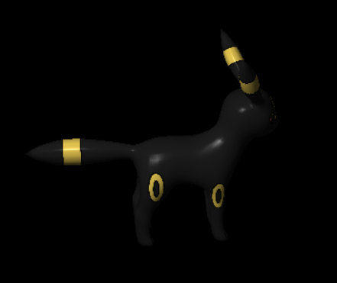
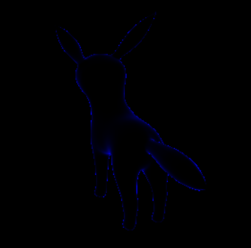
Homework 3
Goal :
Phong shading
Toon shading
Edge effects
Phong shading
Toon shading
Edge effects

Slide 11
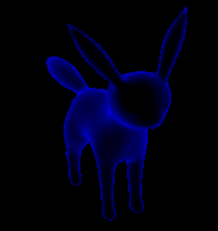
Homework 3 (配分)
1. create shaders and programs you need and can switch them correctly.(5%)
2. Pass all variable to shaders and trigger by Uniform(5%)
3. Implement Phong shading via shader (40%)
4. Implement Toon shading via shader(30%)
# at least define 5 levels.
5. Implement Edge effects via shader(10%)
# must clearly see the edge
# The color of the edge is not specified
6. Report (10%)
This is not allowed

Slide 12
Homework 3 (report)
Please specify your name and student ID in the report.
Explain how you implement the above shading/effects.
(ex: how I get the vector L. I do dot(L, N) for what……etc.)
Describe the problems you met and how you solved them.

Slide 13
Homework 3 (繳交規則)
DeadLine: 2020/ 12 / 22 23: 59:59
Penalty of 10% of the value of the assignment per late week.
If you submit your homework late, the score will be discounted.
submit between (12/23 - 12/29) : Your final score * 0.9
submit between (12/30 - 1/5) : Your final score * 0.8
submit after 1/6 : Your final score * 0.7

Slide 14
Restrictions !!
Your GLSL version should >= #version 330
Deprecated shader syntaxes are not allowed, e.g. attribute, varying
You are only allowed to pass uniform data to shader using glUniform* series function
Using built-in uniform variables in shader is forbidden!
(That is, you cannot use gl_ModelViewMatrix or gl_NormalMatrix …etc)
The only gl_XXX term should be in your shader code is gl_Position.
All the variable used in shaders must use uniform to pass , cannot directly define in shader.

Slide 15
Upload Format
If your uploading format doesn’t match our requirement, there will be penalty to your score. (-5%)
Please hand in the whole project file and report (.pdf) as STUDENTID_Name.zip ​ to e3 platform.
e.g. 0716XXX_王小明.zip
#project file要載下來就可以demo

